Slide 1
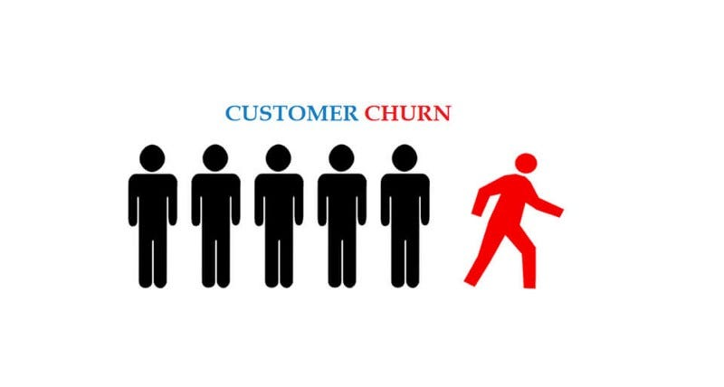




CUSTOMER
CHURN
BY
THARUN

Slide 2

Intoduction
Customer churn is when customers cease their relationship with a company or business, typically by discontinuing their use of its products or services. It is a significant concern for businesses across various industries, including telecommunications, software, e-commerce, and subscription-based services.

Slide 3


Problem Statement:
Predicting Customer Churn in Telecom Industry

Slide 4

Business Use Cases:
Customer Retention: Identify at-risk customers and proactively implement retention strategies.
Marketing Campaigns: Tailor marketing efforts towards customers who are more likely to churn.
Service Improvement: Analyze churn patterns to improve service offerings and customer support.
Revenue Optimization: Reduce churn rates to maintain a steady revenue stream.
Customer Segmentation: Segment customers based on churn probability to offer personalized experiences.

Slide 5

Approach
1. Data Collection: Use SQL to query the telecom database and extract relevant data.
2. Data Preprocessing: Clean and preprocess the data to handle missing values, outliers, and normalize features.
3. Exploratory Data Analysis (EDA): Use Power BI or Tableau for data visualization to identify trends and patterns.
4. Feature Engineering: Create new features that could help in predicting churn.
5. Visualization and Reporting: Create detailed dashboards and reports in Power BI or Tableau to present findings.

Slide 6
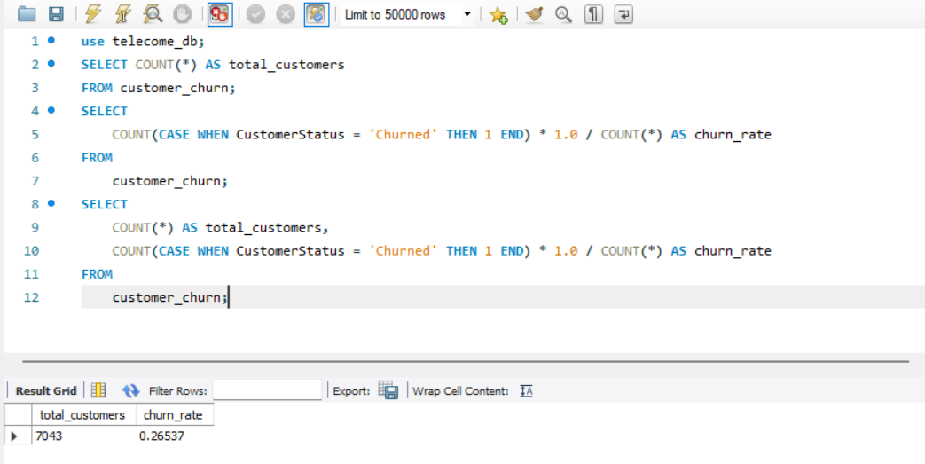

Customer Retention
This analysis show the total customer and total churn rate
Low Churn Rate: A churn rate of 0.2% is exceptionally low. This suggests that the vast majority of your customers are satisfied with the service, or the factors leading to churn are minimal.
Identify the total number of customers and the churn rate

Slide 7
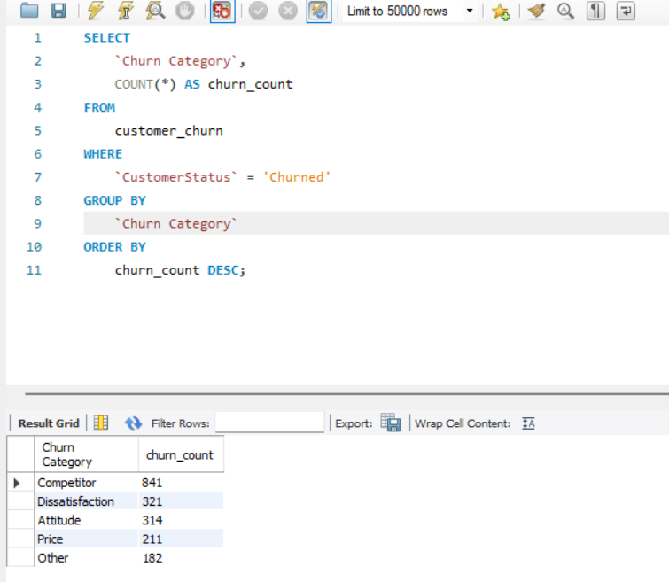

Customer Retention
The most significant reason for churn is customers switching to competitors, accounting for 841 cases.
The second most common reason is dissatisfaction with the service, with 321 cases.
Attitude-related churn accounts for 314 cases, which could be due to negative experiences with support staff or service representatives.
Price is a significant factor, with 211 customers leaving due to cost-related concerns.
There are 182 cases categorized as "Other," which could include various less common reasons for churn.
Determine the most common reasons for churn among customers

Slide 8
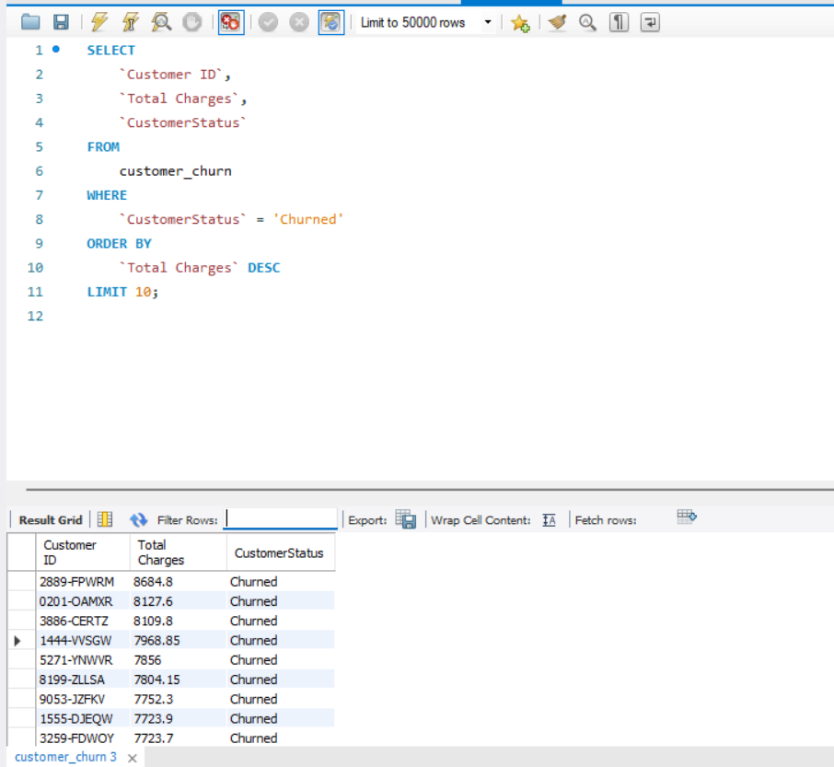

Customer Retention
The results display the top 10 churned customers who had the highest total charges.
The customer with ID 2889-FPWRM had the highest total charges of 8,648.8 before churning.
These customers represent significant revenue losses for the company, and understanding the reasons behind their churn can help prevent similar losses in the future
Identify customers with high total charges who have churned

Slide 9
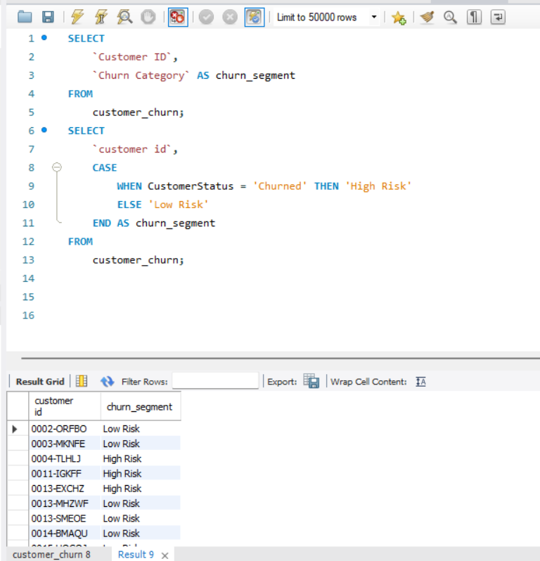

Marketing Campaigns
High Risk Customers: These are customers who have already churned and are at risk of leaving permanently.
Example IDs: 0004-TLHJ, 0011- IGKFF, 0013-EXCHZ
Low Risk Customers: These customers are still with us and less likely to leave.
Example IDs: 0002-ORFBO, 0003- MKNFE, 0013-MHZWF
Segment customers based on churn probability and suggest targeted marketing campaigns

Slide 10
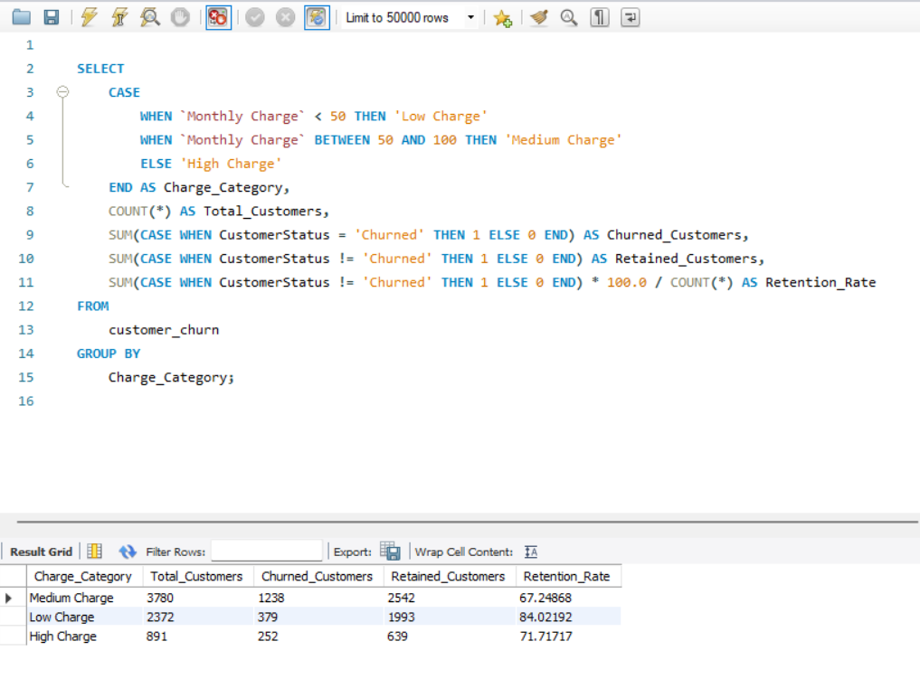

Marketing Campaigns
Analyze the impact of promotional offers on customer retention
Customers with Low Charge have the highest retention rate (84.02%).
Customers with Medium Charge have the lowest retention rate (67.25%).

Slide 11
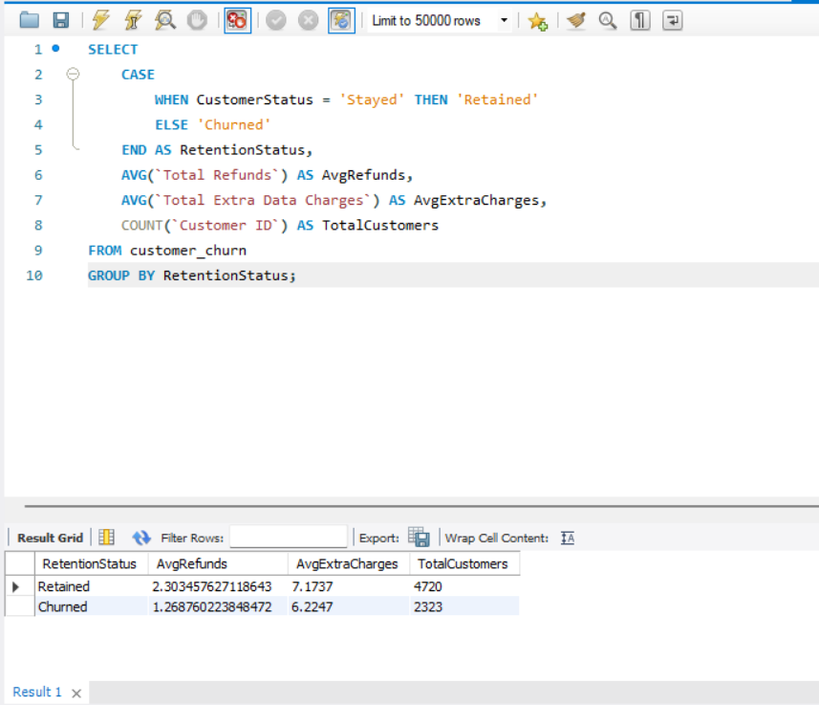

Service Improvement
Retained customers have a higher average refund (2.30) and slightly higher extra charges (7.17) compared to churned customers.
The total number of retained customers (4,720) is more than double that of churned customers (2,323).
Analyze customer support interactions and their correlation with churn

Slide 12
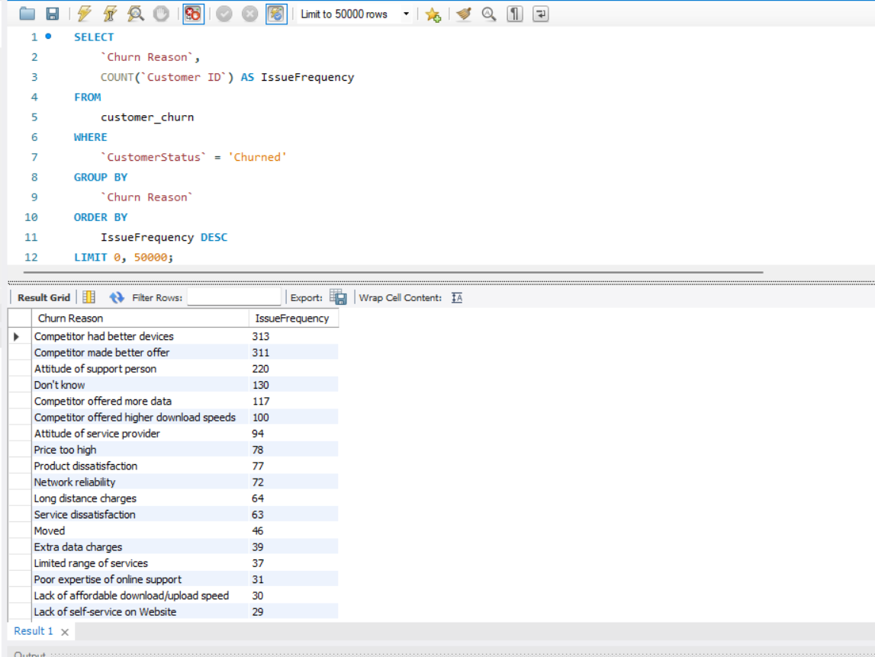

Service Improvement
Top reasons for leaving:
Competitors had better devices (313 customers).
Competitors made better offers (311 customers).
Poor support staff attitude (310 customers).
Other reasons:
Some didn’t know why they left (130 customers).
Competitors offered more data or higher download speeds (117 and 110 customers).
Less common reasons:
High prices, product dissatisfaction, and network reliability were also factors.
Some left because of extra charges, moving, or poor website services.
Identify the most common service issues reported by churned customers

Slide 13
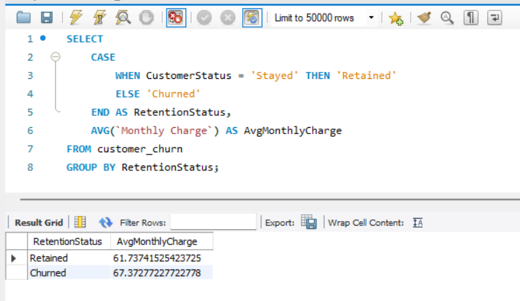

Revenue Optimization
Calculate the average monthly charges for customers who have churned and compare it with those who have not
Retained customers have an average monthly charge of 61.74.
Churned customers have a higher average monthly charge of 67.37.

Slide 14
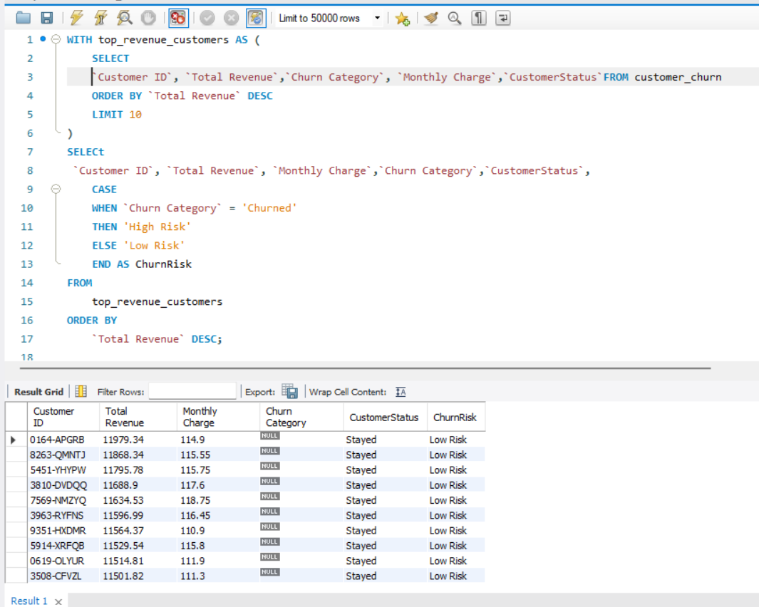

Revenue Optimization
The result grid shows that all the top 10 customers have stayed (CustomerStatus is "Stayed") and are categorized as "Low Risk" for churn. The total revenue for these customers ranges from approximately 11,158.31 to 19,793.94, and their monthly charges range from 111.3 to 114.9.
Identify customers who generate the highest revenue and assess their churn risk

Slide 15
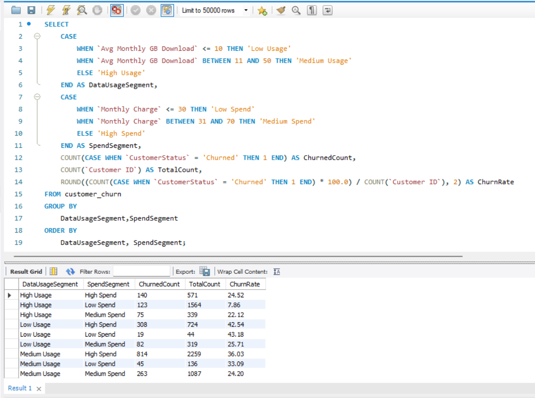

Customer Segmentation
High data users with low spending have the highest churn rate at 72.66%.
Low data users with medium spending have the lowest churn rate at 5.98%.Generally,
customers who spend less are more likely to leave, especially those who use a lot of data.
Segment customers by service usage and analyze churn rates within each segment

Slide 16
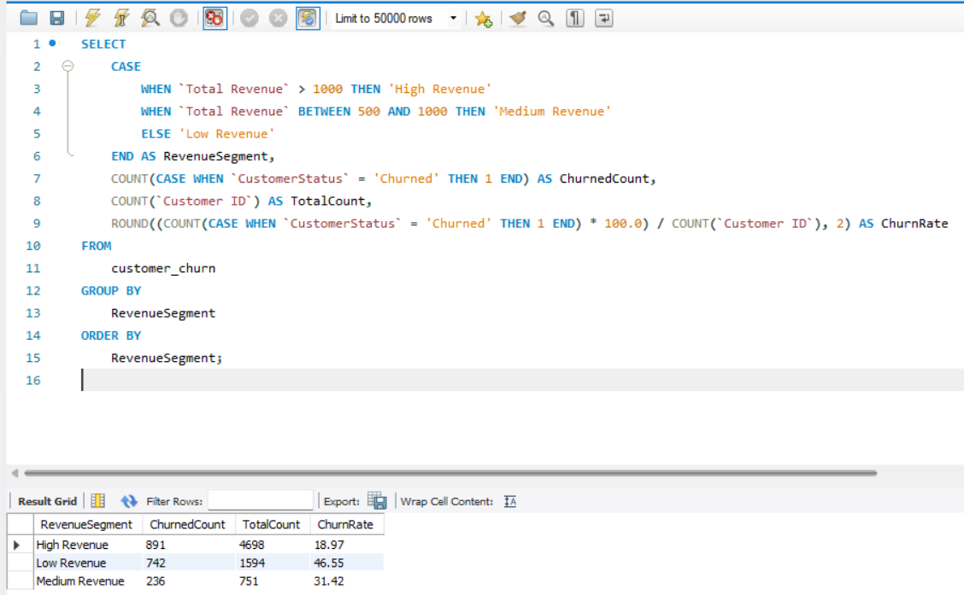

Customer Segmentation
HighRevenue:
ChurnedCustomers: 991
TotalCustomers: 4698
Churn Rate: 18.97%
LowRevenue:
ChurnedCustomers: 742
TotalCustomers: 1594
Churn Rate: 46.54
MediumRevenue:
ChurnedCustomers: 236
TotalCustomers: 751
Churn Rate: 31.42%
Identify the most profitable customer segments and analyze their churn rates

Slide 17
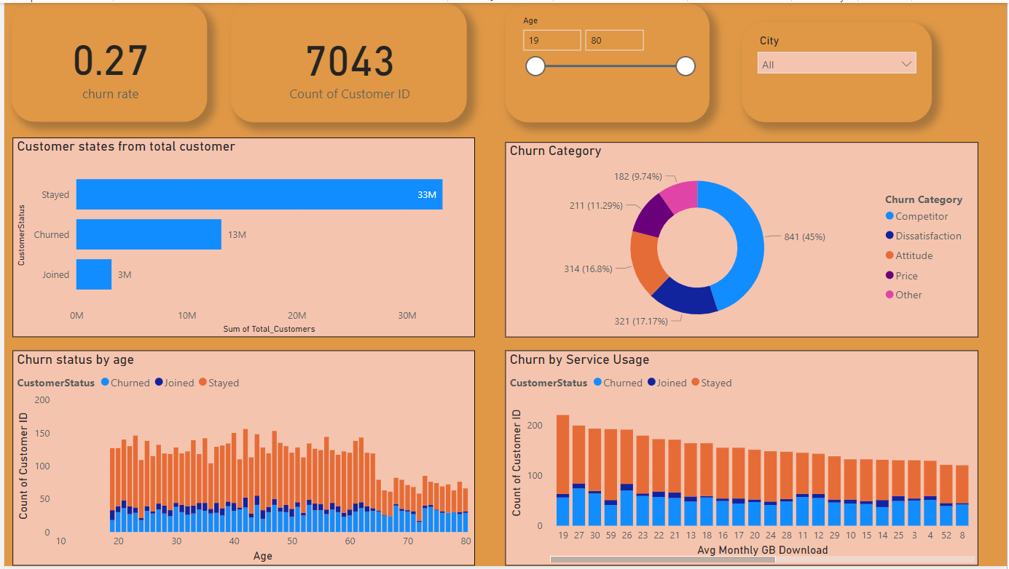

Dashboard of Churn customer

Slide 18

Finding from analysis
Low Churn Rate: The overall churn rate is low at 0.2%, indicating most customers are satisfied.
Primary Reasons for Churn:
Competitor offers and better devices are the top reasons.
Service dissatisfaction and poor support staff attitude are also significant factors.
High costs are another key reason for churn.
High Revenue Customers: Customers with high total charges who churn represent significant revenue losses.

Slide 19

Strategies to Stop Churn
Proactive Customer Retention:
Identify At-Risk Customers: Use data analytics to identify customers who show early signs of dissatisfaction or are considering switching to competitors.
Personalized Offers: Develop personalized offers for these at-risk customers based on their usage patterns and previous interactions.
Improve Customer Support:
Training for Support Staff: Improve training programs for customer support staff to ensure better handling of customer issues, as poor attitude from support staff is a common reason for churn.
Faster Resolution Times: Implement measures to reduce the time taken to resolve customer issues, particularly for high-value customers.
Enhance Service Offerings:
Competitive Pricing: Regularly review pricing models to ensure they are competitive with industry standards, especially for services like high-speed internet and device plans.
Loyalty Programs: Introduce or enhance loyalty programs that reward long-term customers with discounts, free upgrades, or other perks.

Slide 20

Strategies to Stop Churn
Targeted Marketing Campaigns:
Focus on High Churn Segments: Create targeted marketing campaigns aimed at customers in high churn segments, such as low data users with medium spending.
Retention Promotions: Offer promotions that specifically address the reasons for churn, such as better device offers or lower prices.
Service Improvement Based on Feedback:
Feedback Loops: Establish feedback loops where customers can provide feedback on why they might leave or are dissatisfied, and use this information to make data-driven improvements to services.
Regular Check-Ins: Conduct regular check-ins with customers to gauge their satisfaction levels and address any issues before they lead to churn.
Predictive Analytics:
Churn Prediction Models: Implement predictive analytics models to continuously monitor customer data and predict churn before it happens. This allows the company to take preemptive actions.

Slide 21
Thank you

